Slide 1
Self Driving Car
Name:Aishwarya Muchandi
Manan Doshi
Aakash Singh

Slide 2
Outline
What’s autonomous car ?
Our objective
Our project modules
Neural Network
Object detection
Monocular vision and camera calibration
Results

Slide 3
What’s autonomous car ?
Partially or fully drive themselves and which may ultimately require no driver at all.
To make cars safer, drivers more aware, and accidents less likely.
The technology appears close to maturity and commercial introduction.
Reducing the opportunity for human error

Slide 4
Our objective
Modulate a RC car to handle three tasks:
Self-driving on the track.
Stop sign and traffic light detection.
Front collision avoidance and motion planning.

Slide 5
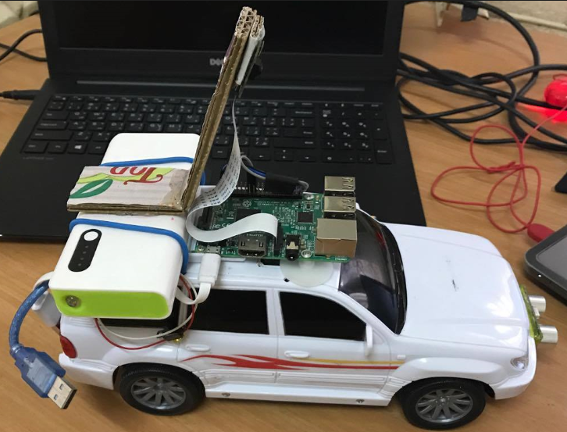
Our project modules
Input Module
Processing Module
Control Module

Slide 6
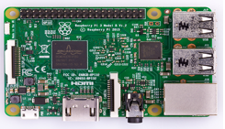
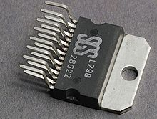
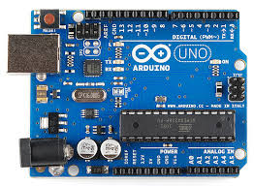
Input Module andProcessing Module
This module consists of a Pi Camera and Raspberry Pi 3 board (model 3B+), attached with a pi camera module, H Bridge AND Ardiuno.

Slide 7
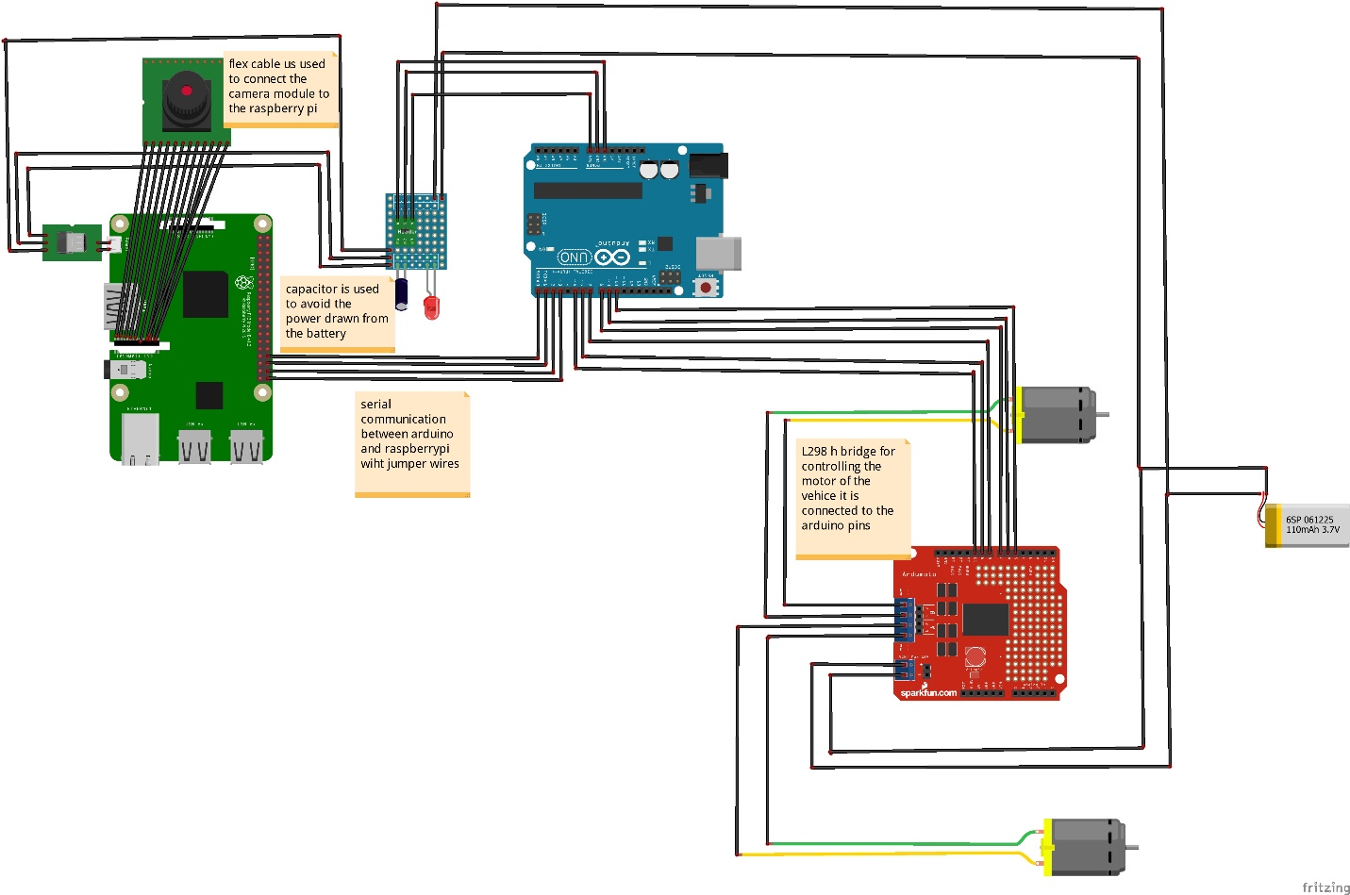
Technology Stack

Slide 8
Processing Module
This module - computer - is responsible for:
Raspberry Pi Recieves the data from DNN after computation,
DNN will process images captured by Pi Camera, and prediction will be made.
Object detection -stop sign and traffic light-distance measurement.
Sending instructions to the Arduino.

Slide 9
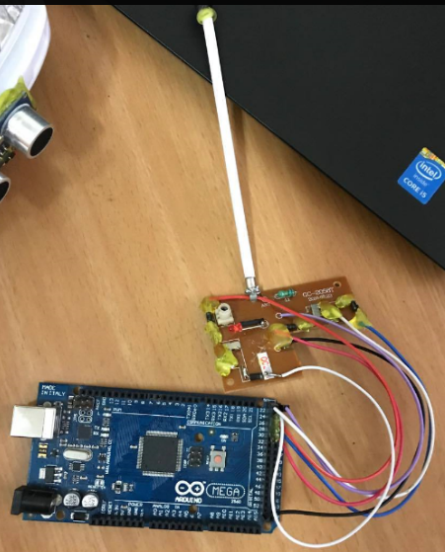
Control Module
An on/off type remote controller controlled by Arduino.

Slide 10
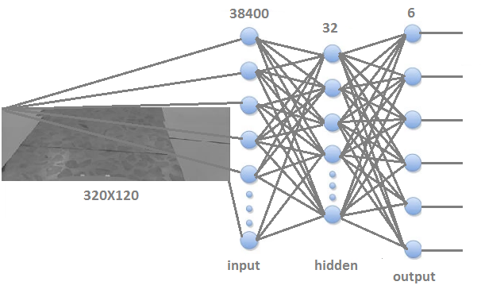
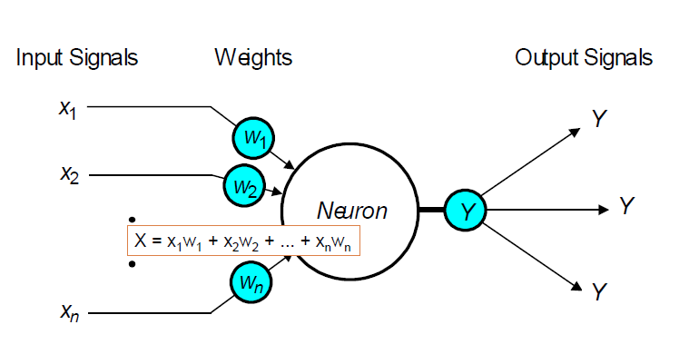
Neural Network

Slide 11
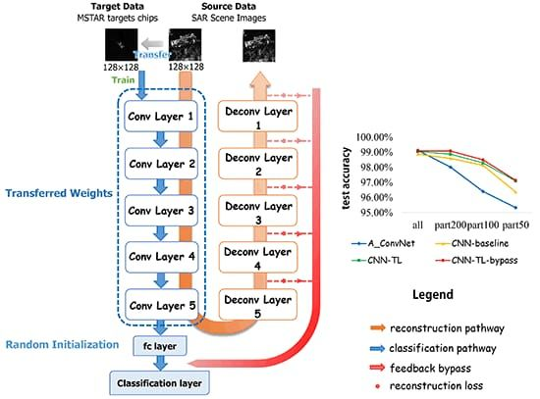
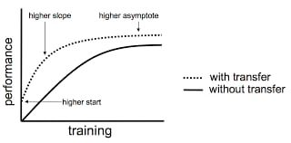
Neural Network

Slide 12
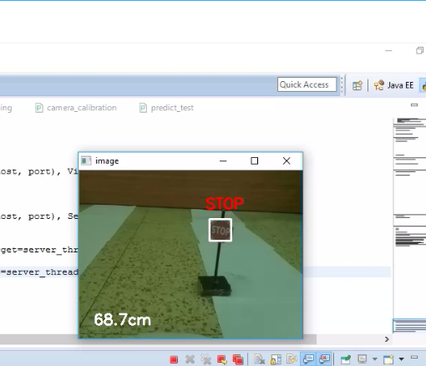
Object detection

Slide 13
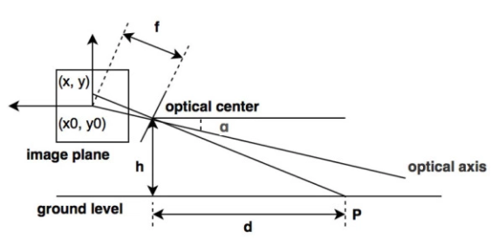
Monocular vision

Slide 14
OpenCV:
It is a powerful computer vision package.​ It can be trained to detect objects in images (or
video).
Tensorflow:
It i​ s ​ Google’s popular deep learning framework. Tensorflow is used to make smart decisions
based on the neural network.
Google Colab:
Colab is a free cloud-based Jupyter Notebooks that let you write and train deep learning
models in Python. The popular python libraries supported are TensorFlow, Keras, OpenCV,
and Pandas
OpenCV for Computer Vision:
Perception Sensor of our PiCar is a USB DashCam. A DashCam gives us a live video, which is
essentially a sequence of pictures. We will use OpenCV, a powerful open source computer
vision library, to capture and transform these pictures
Numpy​ and ​ Matplotlib​ are two very useful python modules that we will use in conjunction
with OpenCV for image processing and rendering.

Slide 15
Tensorflow For CPU:
Raspberry Pi is not recommended to perform any deep learning (i.e. model training),
as its CPU is vastly insufficient for backward propagation, a very slow operation required in
the learning process. However, we can use the ​ Tensorflow CPU​ to do model predictionbased on a pre-trained model. Model Training which uses only forward propagation, a much faster computer operation.
​ COCO (Common Object in COntext) object detection model​ can detect about 100 common objects, like a person etc.The object detection model used in this program is called ​ ssd_mobilenet_coco_v2.

Slide 16
Autonomous Lane Navigation via OpenCV:
Adaptive Cruise Control (ACC) and some forms of Lane Keep Assist System (LKAS). Adaptive cruise control uses radar to detect and keep a safe distance with the car in front of it. Lane Keep Assist System is a relatively new feature, which uses a windshield mount camera to detect lane lines, and steers so that the car is in the middle of the lane. Lane detection concept will turn a video of the road into the coordinates of the detected lane lines.
This will be achieved via the computer vision package: OpenCV. The color space used in the image is RGB (Red/Green/Blue). The RGB will be converted into
HSV (Hue/Saturation/Value) color space.

Slide 17
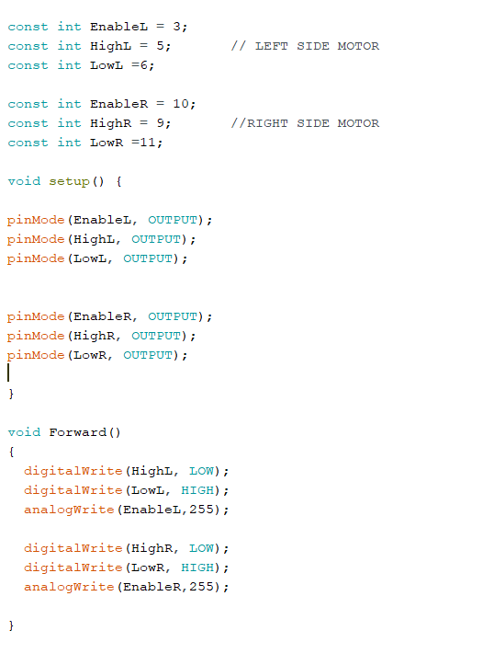
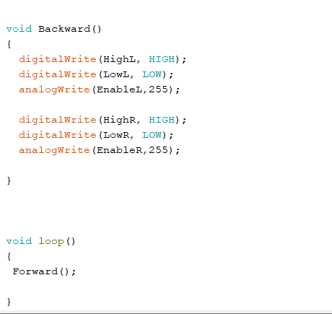

Slide 18
Video Capturing and Converting into Frame

Slide 19
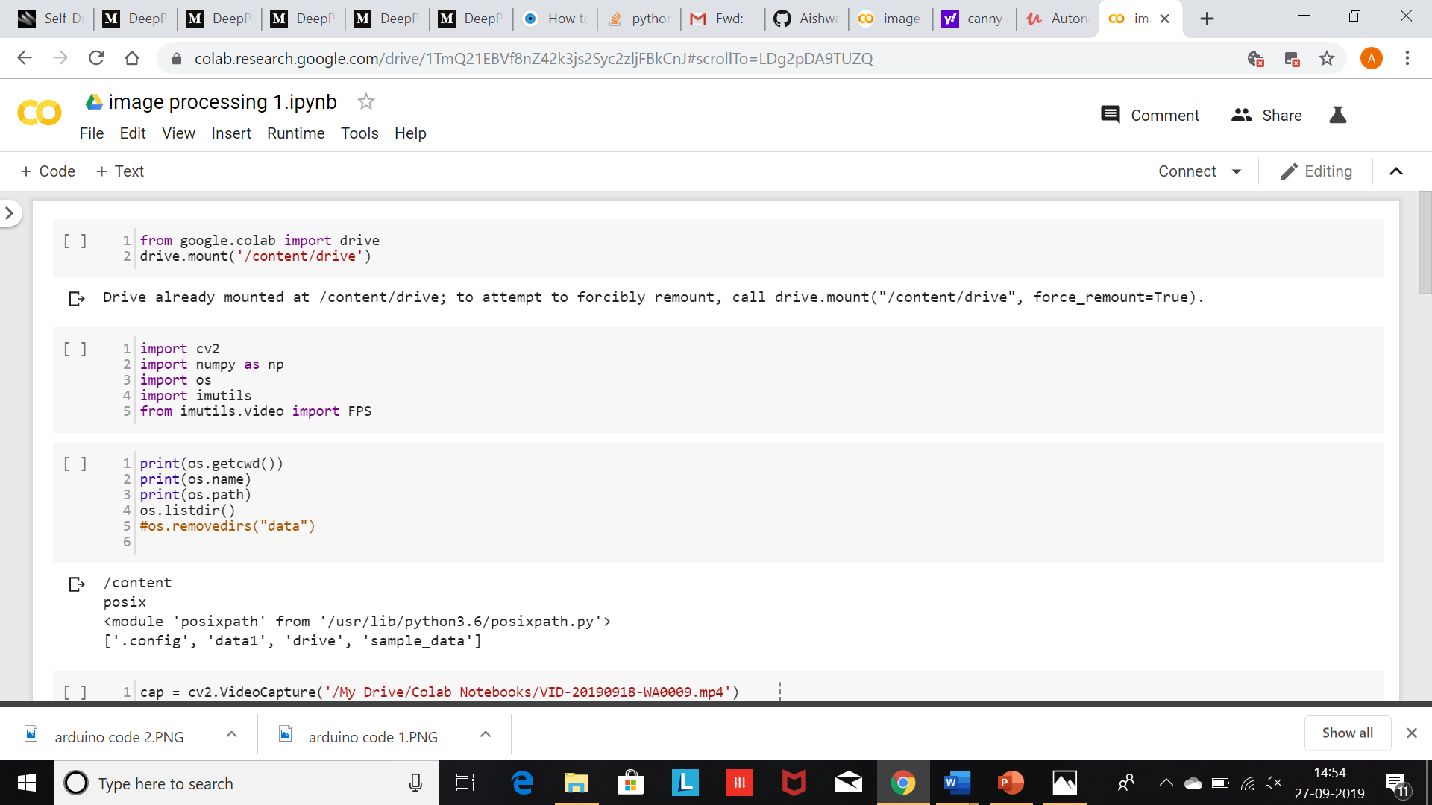

Slide 20
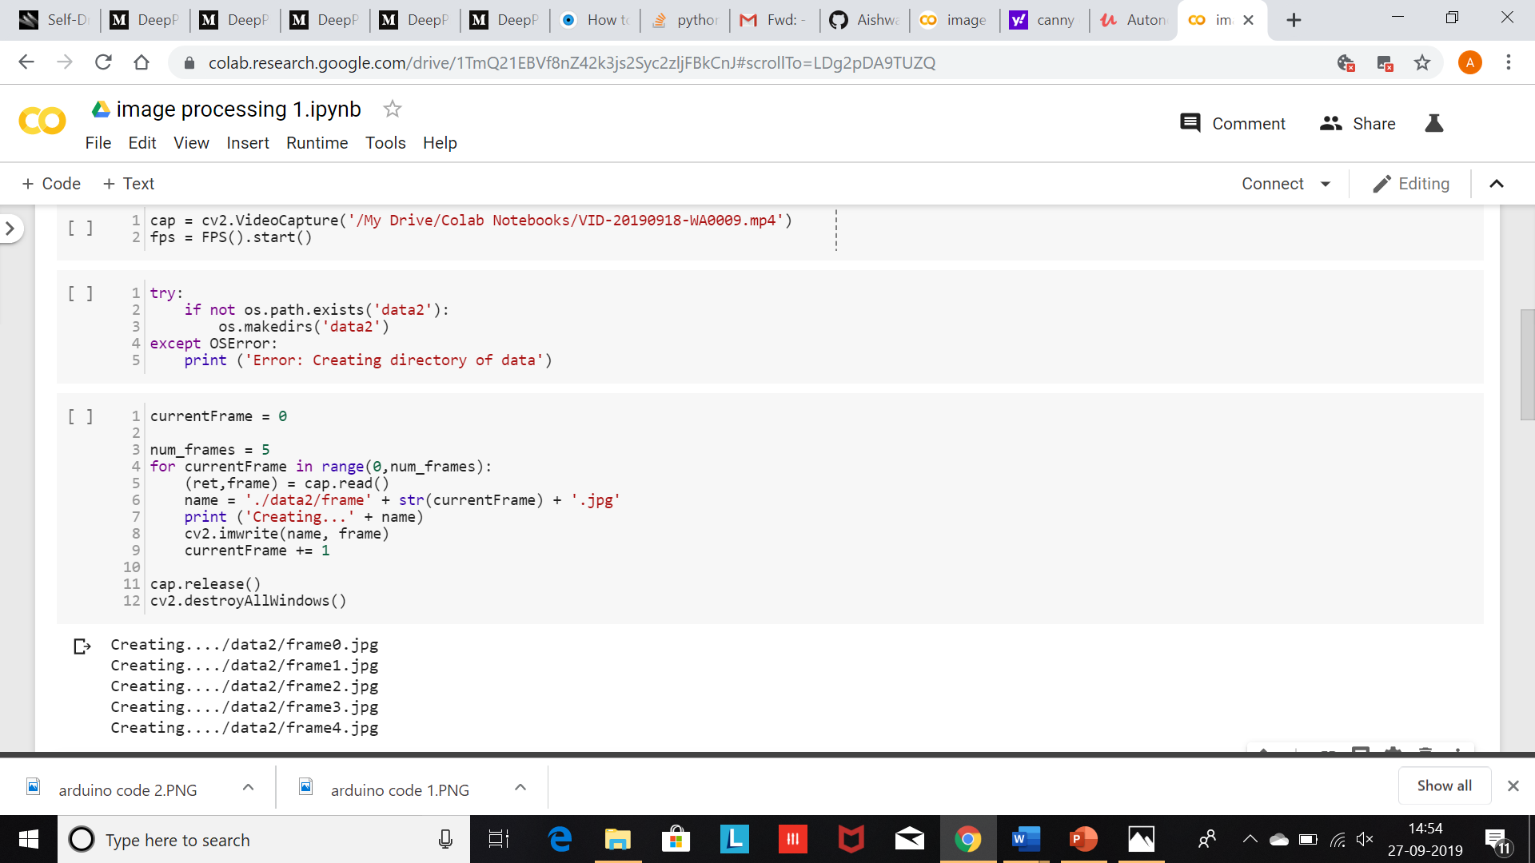

Slide 21
Serial Communication between RaspberryPi and Ardiuno
The Serial Communication between raspberryPi and Ardiuno is done through GPIO pins of Pi (21,22,2,32,24)
To the Ardiuno pin (0,1,2,3) .
The basic Logic is to pass the binary bit to the ardiuno and In Ardiuno these bit are converted into decimal.

Slide 22
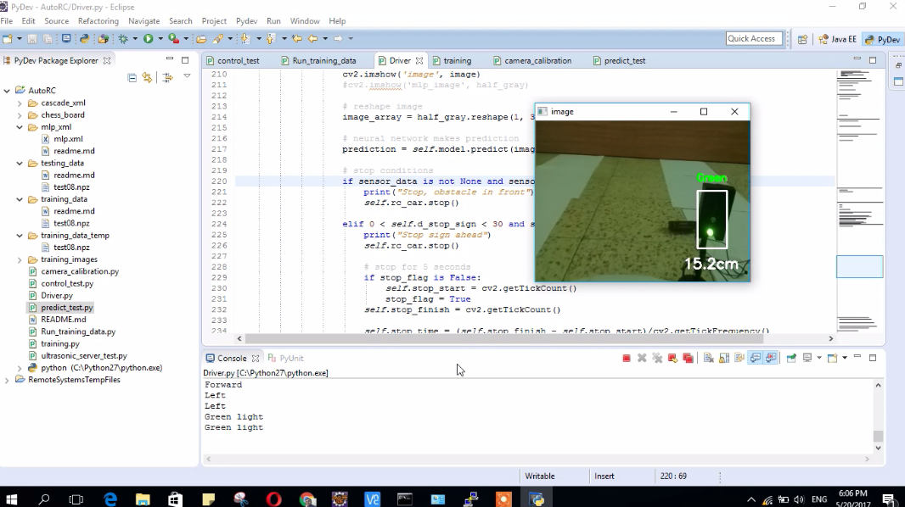
Results

Slide 23
Problems
The low quality build of the car
The remote range was not good and the signal was choppy.
the rechargeable batteries life was short.
we had to use a power bank and it was heavy.
we needed to slow the motor in order to get a better result out of training.

Slide 24
Conclusions
We learned a lot about :
Neural Networks and its algorithms.
Image processing
Raspberry pi and Arduino

